Slide 1
Study of exotic hadrons in effective models for chiral doubling of charmed mesons
Masayasu Harada (Nagoya Univ.)
at Heavy Quark Hdrons at J-PARC 2012
(Tokyo Institute of Technology, June 21, 2012)
Based on
・ M.H., H.Hoshino and Y.L.Ma, Phys. Rev. D85, 114027 (2012)
・ M.H. and Y.L.Ma, work in progress

Slide 2
1. Introduction

Slide 3
Chiral partner structure
Chiral symmetry breaking generates the mass splitting between chiral partners.
examples :
N(940) left ⇔ N(940) right
[ N(940) ⇔ N*(1535) ]
pi(130) ⇔ sigma(600)
[ pi(130) ⇔ rho(770) ]
(D, D*) ⇔ (D₀*, D₁)

Slide 4
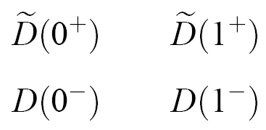
“chiral doubling”
M.A.Nowak, M.Rho and I.Zahed, PRD48, 4370 (1993)
excited states
heavy quark
symmetry
(heavy quark
partner )
ground states
chiral symmetry (chiral partner)
M_{D(0+,1+)} – M_{D(0-,1-)} ~ 0.43 GeV
Chiral doubling seems to work.

Slide 5
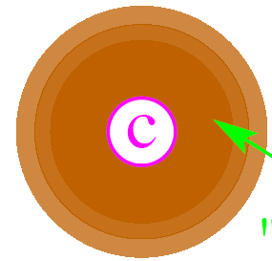
-
☆ Heavy-Light Mesons (Qq type) Baryons (Qqq)
“Light-quark cloud” (Brown Muck)
・・・ made of light quarks and gluons
typical energy scale ～ Λ_{QCD}
Q
◎ Heavy mesons ・・・ 3 or 3^{bar}, … of SU(3)_{l}
◎ Heavy baryons ・・・ 6, … of SU(3)_{l}
Flavor representations, which do not exist in the light quark
sector, give a new clue to understand the hadron structure.

Slide 6
“chiral doubling”
I shall show what we can learn, from the chiral doubling structure in the heavy meson sector, for
the chiral doubling structure
in the light meson sector
(chiral partner to pion = sigma meson ?)
the chiral doubling structure
in the heavy baryon sector
(chiral partner to Λ_{c} and/or Λ_{b} ?)

Slide 7
Outline
Introduction
A brief review of chiral doubling
Study of sigma meson structure using a model based on the chiral doubling
Chiral doubling in heavy baryons
Summary

Slide 8
2. A Brief review of chiral doubling
Heavy quark symmetry and the chiral symmetry

Slide 9
☆ Heavy quark symmetry
・・・ a symmetry of QCD at M_{Q} → ∞ limit
◎ velocity super-selection rule
gluon
heavy quark
The velocity of a heavy quark is
not changed by the QCD interaction.
◎ Heavy quark number conservation
No pair production of heavy quarks by QCD interaction.
◎ SU(2) spin symmetry
QCD interaction cannot flip the spin of heavy quarks.

Slide 10
Fluctuation mode around the On-shell Heavy Quark
energy of
fluctuation mode
energy of heavy quark
on-shell energy of
heavy quark at rest
・・・ Expansion parameter

Slide 11
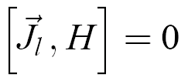
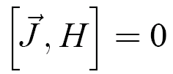
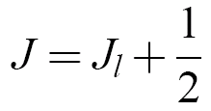
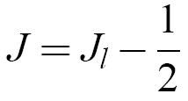
-
☆ Heavy-Light Mesons (Qq type)
“Light-quark cloud” (Brown Muck)
・・・ made of light quarks and gluons
typical energy scale ～ Λ_{QCD}
Q
angular momentum
carried by “Brown muck”
◎ spin of meson
spin of heavy quark
・ M_{Q} → ∞ limit
same Ｊ_{ｌ}
Q(↑)
Q(↓)
conservation of J_{l}
⇒ classification of hadrons by J_{l}
Heavy Meson Multiplet
・・・ degenerate masses

Slide 12
Heavy meson multiplets
Ground states ・・・ J_{l} =1/2 ; J^{P} = (0⁻ , 1⁻)
Pseudoscalar meson D ; Vector meson D*
D = ( D⁰, D⁺ , D_{s}) D* = ( D*⁰, D*⁺ , D_{s}*)
Excited states ・・・ J_{l} =1/2 ; J^{P} = (0⁺ , 1⁺)
Scalar meson D₀* ; Axial-vector meson D₁
D₀* = ( D₀*⁰, D₀*⁺ , D_{s0}*) D₁ = ( D₁⁰, D₁⁺ , D_{s1} )
chiral partner

Slide 13
3. Study of sigma meson structure using a model based on the chiral doubling
Based on
・ M.H., H.Hoshino and Y.L.Ma, Phys. Rev. D85, 114027 (2012)

Slide 14
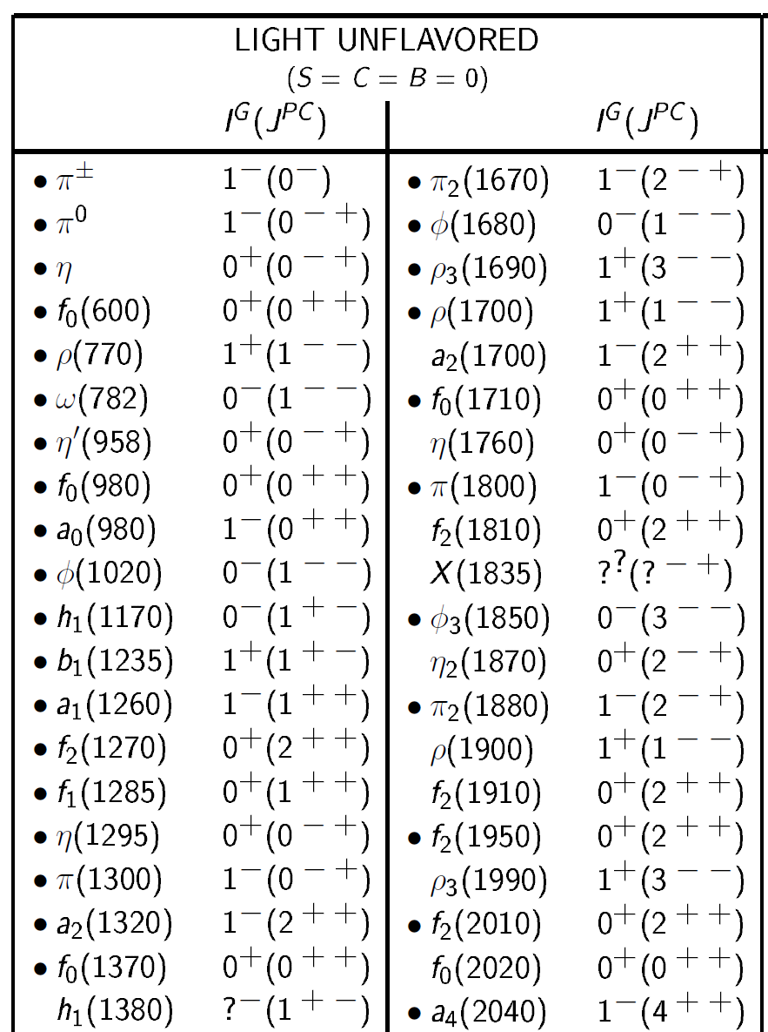
Clue to understand the chiral symmetry breaking
“σ” particle (“QCD Higgs” particle)
・・・ Quantum fluctuation of the condensate
A candidate
・・・ f₀(600) : lightest I=0 scalar meson
However, f₀(600) may not be a qq^{bar} meson !
PDG 2009

Slide 15
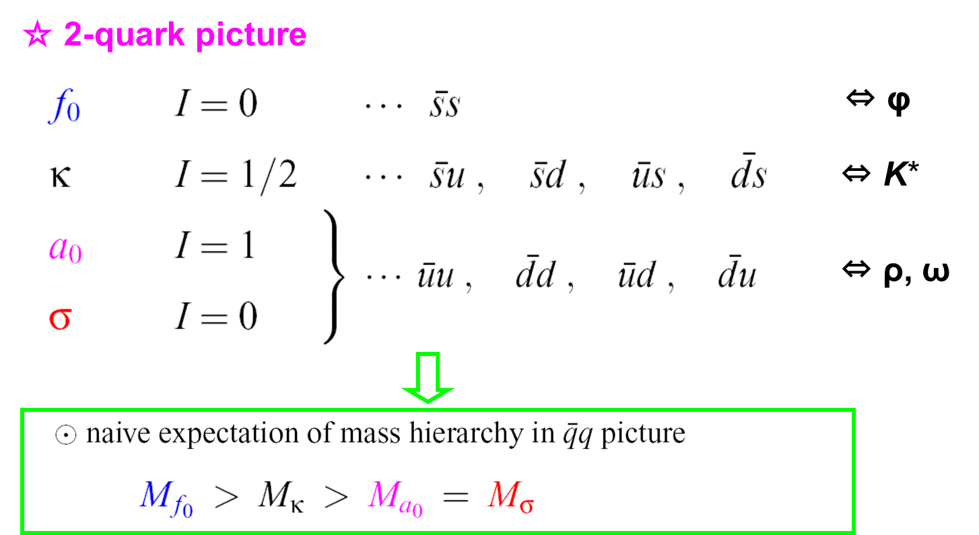
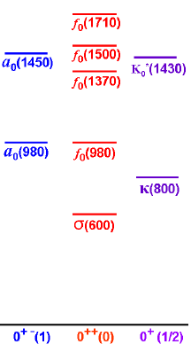
Scalar meson puzzle
mass (MeV)
Contradiction ?
$$J^{PG}(I)$$

Slide 16
Scalar meson puzzle
mass (MeV)
Consistent ?
$$J^{PG}(I)$$

Slide 17
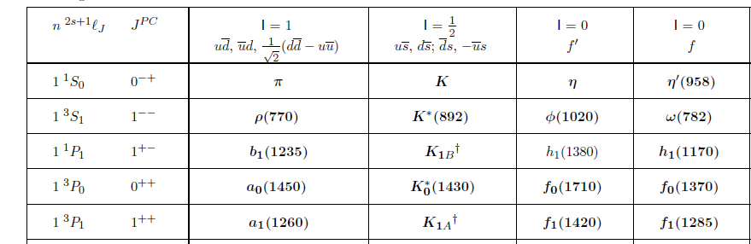
◎ Standard qq^{bar} quark model assignment
What is f₀(600) ?
2 quark ( qq^{bar} ) state
4 quark ( qqq^{bar}q^{bar} ) state
?
“σ” particle
Exotic hadron

Slide 18
Outline of this section
Study of sigma meson structure using a model based on the chiral doubling
Linear sigma model for light quark sector including σ meson
σ meson in ππ scattering
An effective model for σ meson coupling to chiral doublers
σ meson in D₁ → Dππ decay

Slide 19
A) Linear sigma model for light quark sector including σ meson

Slide 20
2 and 4 quark states in linear sigma model
3×3 matrix fields ＆ (Linear Sigma Model):
２quark field ～
４quark field ～
Scalar
Pseudo scalar
Scalar
Pseudo scalar
These transform in the same way under SU(3)L×SU(3)R :
In general, there can be a four quark state:
SU（３）R× SU（３）L：
Different transformations under U(1)A :
2
４
ｑ
ｑ
ｑｑ
ｑｑ
U（1）A：
ν：位相
UL,UR：フレーバー３×３ユニタリ行列

Slide 21
mixing
When the U(1)A symmetry exists, 2-quark state and 4-quark state do not mix with each other. But, U(1)A symmetry is broken
by anomaly explicitly
by spontaneous chiral symmetry breaking
⇒ mixing between 2-quark state and 4-quark state
$$\left({φ_{π} \atop {φ′}_{π}}\right)=\left(\begin{matrix}\cos{θ_{π}} & −sin{θ_{π}} \\ \sin{θ_{π}} & \cos{θ_{π}}\end{matrix}\right)\left({π(140) \atop π(1300)}\right)$$
$$\left({\begin{matrix}u\overline{u}+d\overline{d} \\ s\overline{s}\end{matrix} \atop \begin{matrix}us\overline{us}+ds\overline{ds} \\ ud\overline{ud}\end{matrix}}\right)=\left(\begin{matrix}U_{1σ} & ⋯ & \\ ⋮ & 4×4 matrix & \\ & & \end{matrix}\right)\left({\begin{matrix}σ \\ {(f_{0})}_{2}\end{matrix} \atop \begin{matrix}{(f_{0})}_{3} \\ {(f_{0})}_{4}\end{matrix}}\right)$$
Lightest
2nd
3rd
Heaviest

Slide 22
An effective Lagrangian
Linear sigma model including 2-nonet fields
: SU(3)L×SU(3)R invariant, U(1)A invariant.
includes SU(3)×SU(3) invariant terms which can include U(1)A variant - anomaly effect - terms.
: SU(3)L×SU(3)R invariant, U(1)A breaking (anomaly).
constrained by anomaly matching with QCD
: Explicit SU(3)L×SU(3)R×U(1)A breaking terms.
(effects of current quark masses)
includes SU(3)×SU(3) variant terms.

Slide 23
B) σ meson in ππ scattering

Slide 24
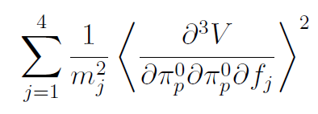
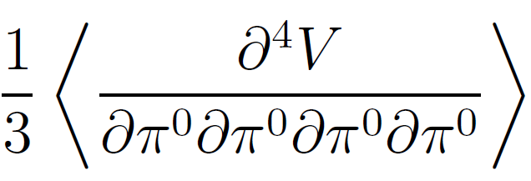
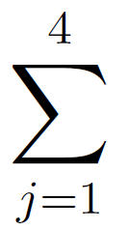
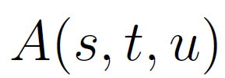
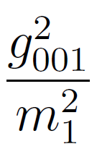
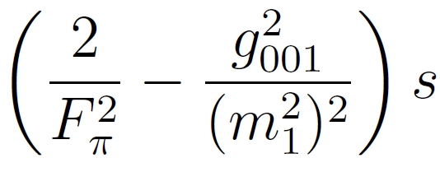
ππ scattering amplitude
Relations among coupling constants due to the chiral symmetry
$$f_{j}$$
π
π
π
π
π
π
ππ scattering amplitude includes σππ couping and sigma mass
in the low energy region
σ
expansion of $\left(\frac{s}{{m_{j}}^{2}}\right)$ and approximation ($j≥2, \sqrt{s}≲560$MeV)

Slide 25
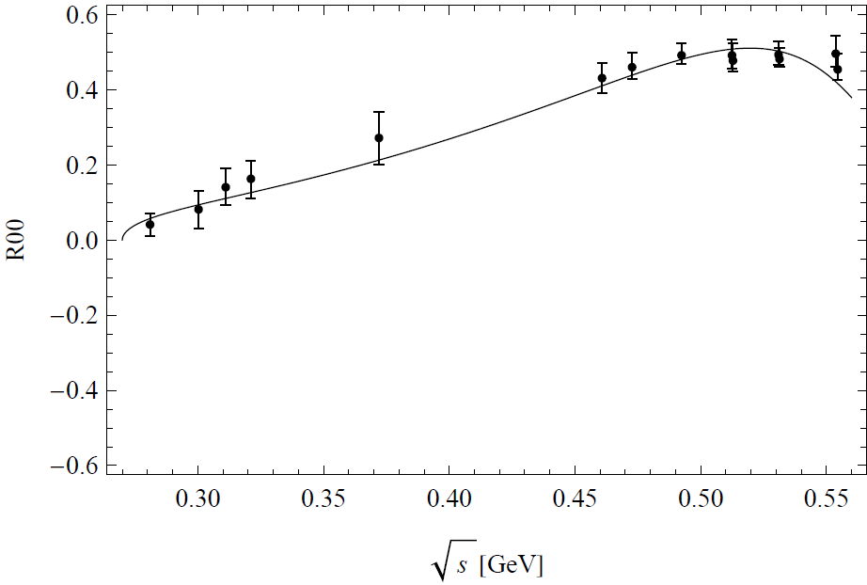
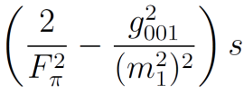
Fit to pp scattering data
m(σ) = 580MeV,
ππσcoupling = 1.9
$$g_{σππ}^{2}\sim {(2.2GeV)}^{2}$$
$$m_{σ}^{}\sim 606MeV$$

Slide 26
C) An effective model for σ meson coupling to chiral doublers

Slide 27
Heavy meson effective field
☆ Ground states ・・・ J_{l} =1/2 ; J^{P} = (0⁻ , 1⁻)
Pseudoscalar meson D ; Vector meson D*
D = ( D⁰, D⁺ , D_{s} ) D* = ( D*⁰, D*⁺ , D_{s}*)
・ Bi-spinor field
;
Ψ ・・・ light constiuent quark field
annihilates heavy mesons (not generate)
☆ Excited states ・・・ J_{l} =1/2 ; J^{P} = (0⁺ , 1⁺)
Scalar meson D₀* ; Axial-vector meson D₁
D₀* = ( D₀*⁰, D₀*⁺ , D_{s0}*) D₁ = ( D₁⁰, D₁⁺ , D_{s1} )

Slide 28
Heavy meson effective field
◎ chiral doubler fields
・ transformation under the chiral symmetry
・ transformation under U(1)A
2-quark meson
4-quark meson
tr[$H_{L}M {\overline{H}}_{R}]$is allowed, but tr[$H_{L} M^{′}{\overline{H}}_{R}$] is not
$→$ only 2-quark meson can couple to heavy meson

Slide 29
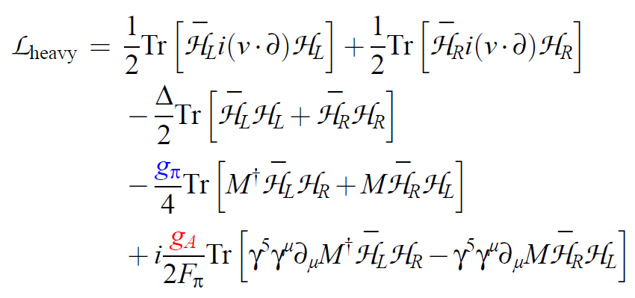
Model Lagrangian
term generates mass difference between (D, D*) and (D₀*, D₁).
We use physical masses as inputs to determine Δ.

Slide 30
Detemination of parameters
・ $g_{A}$ : detemined from D* → D π decay
・ $g_{π}$ : detemined from D₀* → D π decay

Slide 31
D) σ meson in D₁ → Dππ decay

Slide 32
D₁ → Dππ decay amplitude
reduced in the low energy region [ $s ≪ m_{fj} \left(j=2,3,4\right)$ ]
mixing parameter

Slide 33
Isospin & partial wave projection
To make the sigma meson contribution clearer, we made
the projection of the amplitude onto I = 0, S-wave amplitude.
From this, we can see that the final state interaction
do not change the decay width.
$e^{iδ} ( δ :$phase shift of$ππ$scattering )

Slide 34
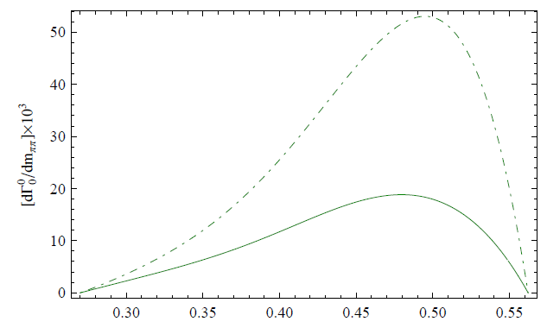
D₁ → Dππ decay width
Note : There is 4-way ambiguity of signs of g_{σππ} and g_{π} .
g_{σππ} > 0
g_{π} > 0
h = 1
h = 0
We expect that π is dominantly 2-quark state,
so cosθ_{π} $≈$1.

Slide 35
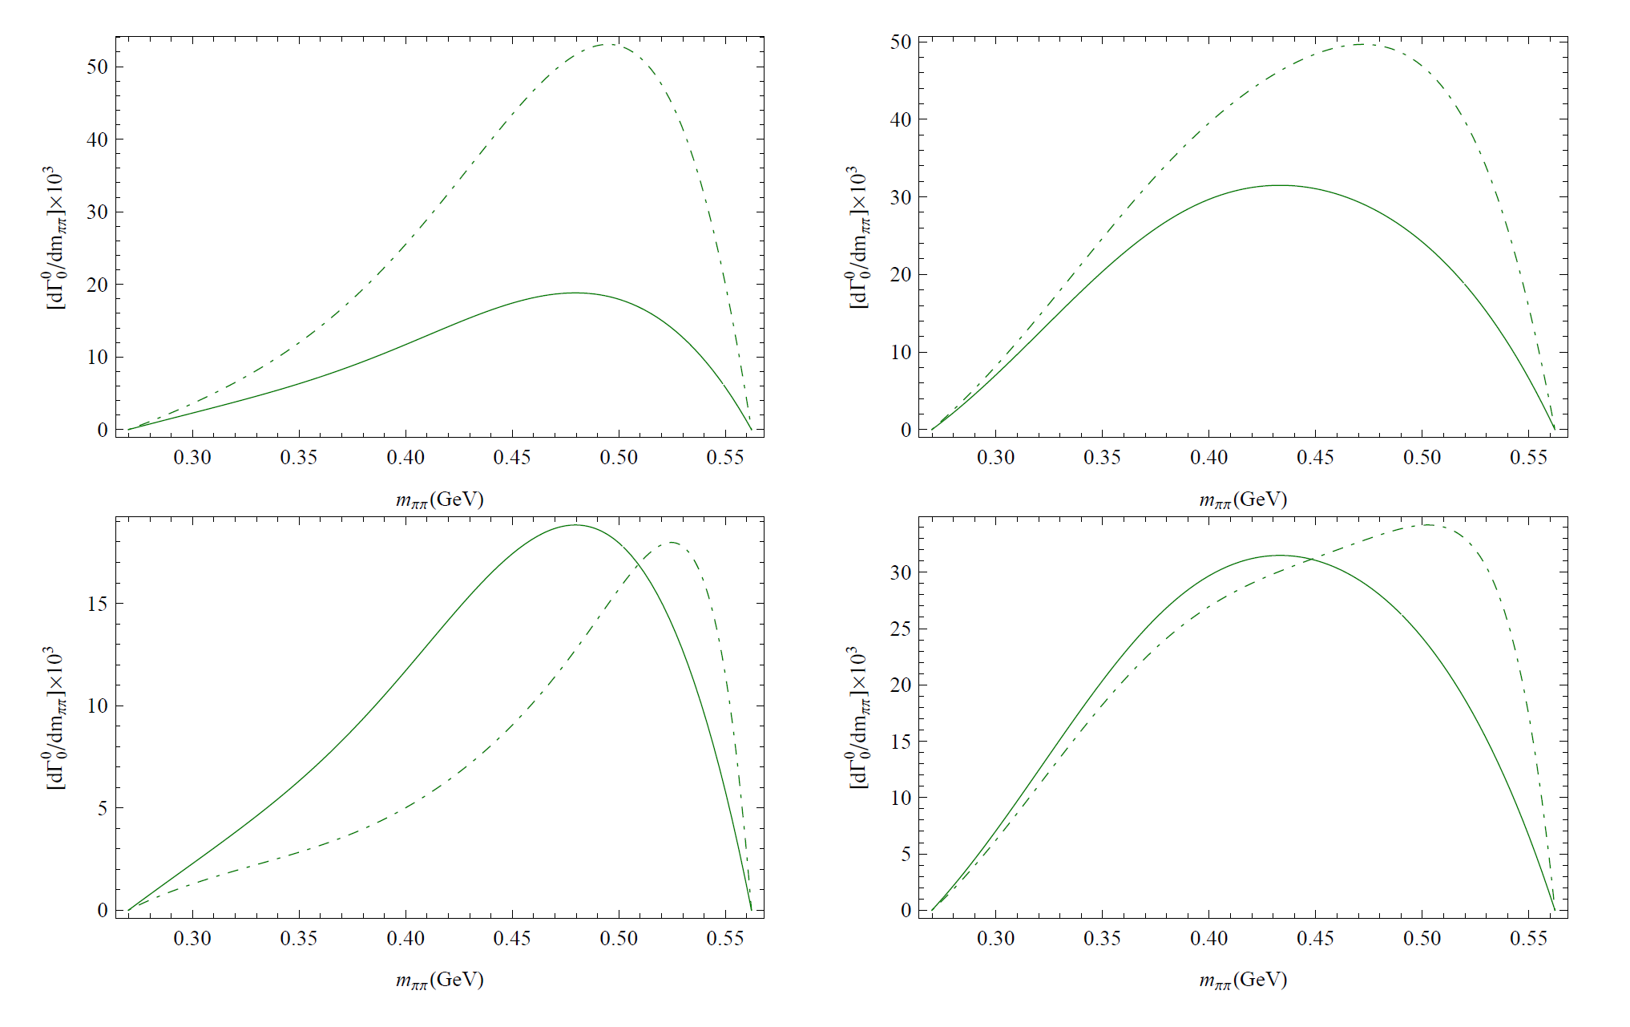
D₁ → Dππ decay width
g_{σππ} > 0
g_{π} < 0
g_{σππ} > 0
g_{π} > 0
g_{σππ} < 0
g_{π} < 0
g_{σππ} < 0
g_{π} > 0
Constituent of sigma meson may be detemined by
future experiment

Slide 36
4. Chiral doubling in heavy baryons
Based on
・ M.H. and Y.L.Ma, work in progress

Slide 37
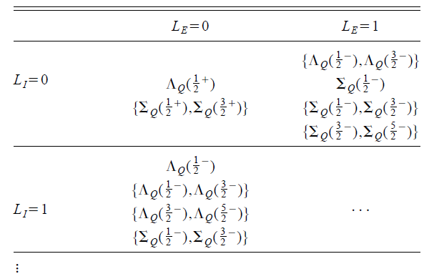
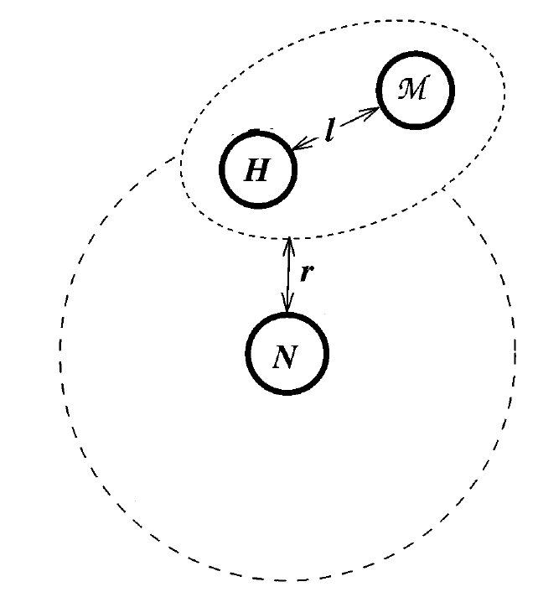
Chiral doubling in heavy baryons
・・・ based on the boundstate approach to heavy baryons
☆ Boundstate approach
heavy baryons (qqQ type)
= heavy meson (q^{bar}Q) bound to nculeon (qqq) as a soliton
heavy meson
r = 0
r = 1
q
l=0
Q
D(0⁻,1⁻)
l=1
D(0⁺,1⁺)
D(1⁺,2⁺)
・kinematical structure is same as the constituent quark model
M.H., F.Sannino, J.Schechter and H.Weigel, PRD56, 4098 (1997)

Slide 38
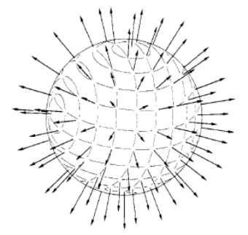
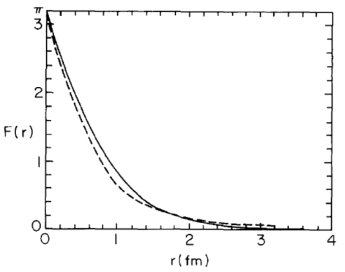
Nucleon as Skyrme soliton
Skyrme model
hedgehog ansatz
☆ EoM for F(r)
－
☆ Solution with Baryon number = 1
☆ Soliton mass

Slide 39
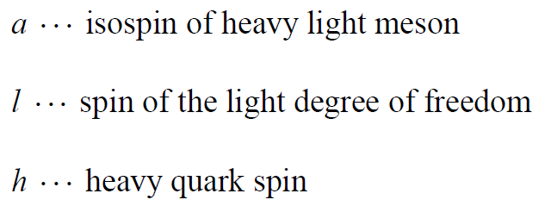
Heavy meson Lagrangian
☆ Integrating out scalar mesons and keeping pion only
・ Redefine the fields as
・ Ansaz for classical solution

Slide 40
Quantum number & Binding energy
・ Spin of heavy baryon (bound state)
・ Binding energy for H ~ (D, D*) with r = 0 (ground state)
from Adkins-Nappi-Witten
・ Assume g_{A} > 0 for a bound state in K=0
⇒ Λ_{c}(1/2⁺) is the ground state

Slide 41
Mass of Λ_{c}(1/2⁺)
M(Λ(1/2+)) = M_{N} + M_{D(0-,1-)} – 1.06 g_{A} (GeV)
M_{D(0-,1-)} = ( M_{D(0-)} + 3 M_{D(1-)} )/4 ~ 1.97 (GeV)
M_{N} = 0.94 (GeV)
g_{A} = 0.56 from D(1⁻) → D(0⁻) + π decay
M(Λ(1/2⁺)) = 2.32 (GeV)
M(Λ(1/2⁺))^{exp} = 2.286 (GeV)
◎ Bound state approach seems to work !

Slide 42
Chiral partner to Λ_{c}(1/2⁺) ?
◎ Binding energy for G ~ (D₀, D₁*) with r = 0
・ overall sign is opposite ⇒ bound state is realized for K = 1
Chiral partner to Λ_{c}(1/2⁺) = [ Λ_{c}(1/2⁻), Λ_{c}(3/2⁻) ]
◎ Mass
M_{D(0+,1+)} = ( M_{D(0+)} + 3 M_{D(1+)} )/4 ~ 2.4(GeV)
M(Λ) = M_{N} + M_{D(0+,1+)} – 0.35 g_{A} = 3.1 (GeV)
・Λ_{c}(1/2-;2595) is unlikely the chiral partner to Λ_{c}(1/2+;2286)
・{Λ_{c}(1/2-;2595) , Λ_{c}(3/2-;2625) }
・・・ r = 1 boundstate of D(0-,1-) and nucleon

Slide 43
Effects of ω meson
K = 0
from: Y.L.Ma, Y.Oh, G.Yang, M.Harada, H.Lee, B.Y.Park, M.Rho, in preparation;
Y.L.Ma, Y.Oh, G.Yang,. M.Harada, in preparation
M(Λ(1/2⁺))^{exp} = 2.286 (GeV) is used to determin g_{ω} = 0.717
K = 1
M(Λ) = 3.1 (GeV) !

Slide 44
☆ Chiral partner to Λ(1/2+)
◎ excited heavy baryons (qqQ type)
= heavy meson + nculeon with angular momentum
or
excited heavy meson + nucleon
r, l : angular momentum
heavy meson
r = 0
r = 1
q
l=0
Q
D(0⁻,1⁻)
l=1
3.1 GeV
D(0⁺,1⁺)
D(1⁺,2⁺)

Slide 45
Application to pentaquark
K = 1 gives a bound state.
M(Θ_{c}(1/2-, 3/2-)) ~ 2.4 (GeV)
cf : M(Θ_{c}(1/2-)) ~ 2.7 GeV without ω contribution.
Y.Oh, B.-Y.Park, and D.P.Min, PLB331, 362 (1994)
note : CHORUS exp. did not observe Θ_{c}(2710).
NPB 763 (2007) 268
☆ chiral partner to pentaquark ?
K = 0
M(Θ_{c}(1/2+)) ~ 2.3 (GeV) !
cf : M(Θ_{c}(1/2+)) = 3052 ± 60 MeV
M.A.Nowak et al., PRD70, 031503(2004)

Slide 46
5. Summary
Based on the chiral doubling structure of D mesons I showed the following 2 analyses:
◎ effect of the sigma meson to D₁ → Dππ decay
Our result indicates that we can get some clue to understand the composition of the sigma meson from future experiment.
◎ Chiral doubling of heavy baryons
Our result implies that the chiral partner to Λ_{c}(1/2⁺) is [ Λ_{c}(1/2⁻), Λ_{c}(3/2⁻) ]. Then, {Λ_{c}(1/2-;2595) , Λ_{c}(3/2-;2625) } is r = 1 boundstates of D(0-,1-) and nucleon
M(Θ_{c}(1/2-, 3/2-)) = 2.4 (GeV) ; M(Θ_{c}(1/2+)) ~ 2.3 (GeV)
Analysis with effect of rho meson is on-going.

